Slide 1
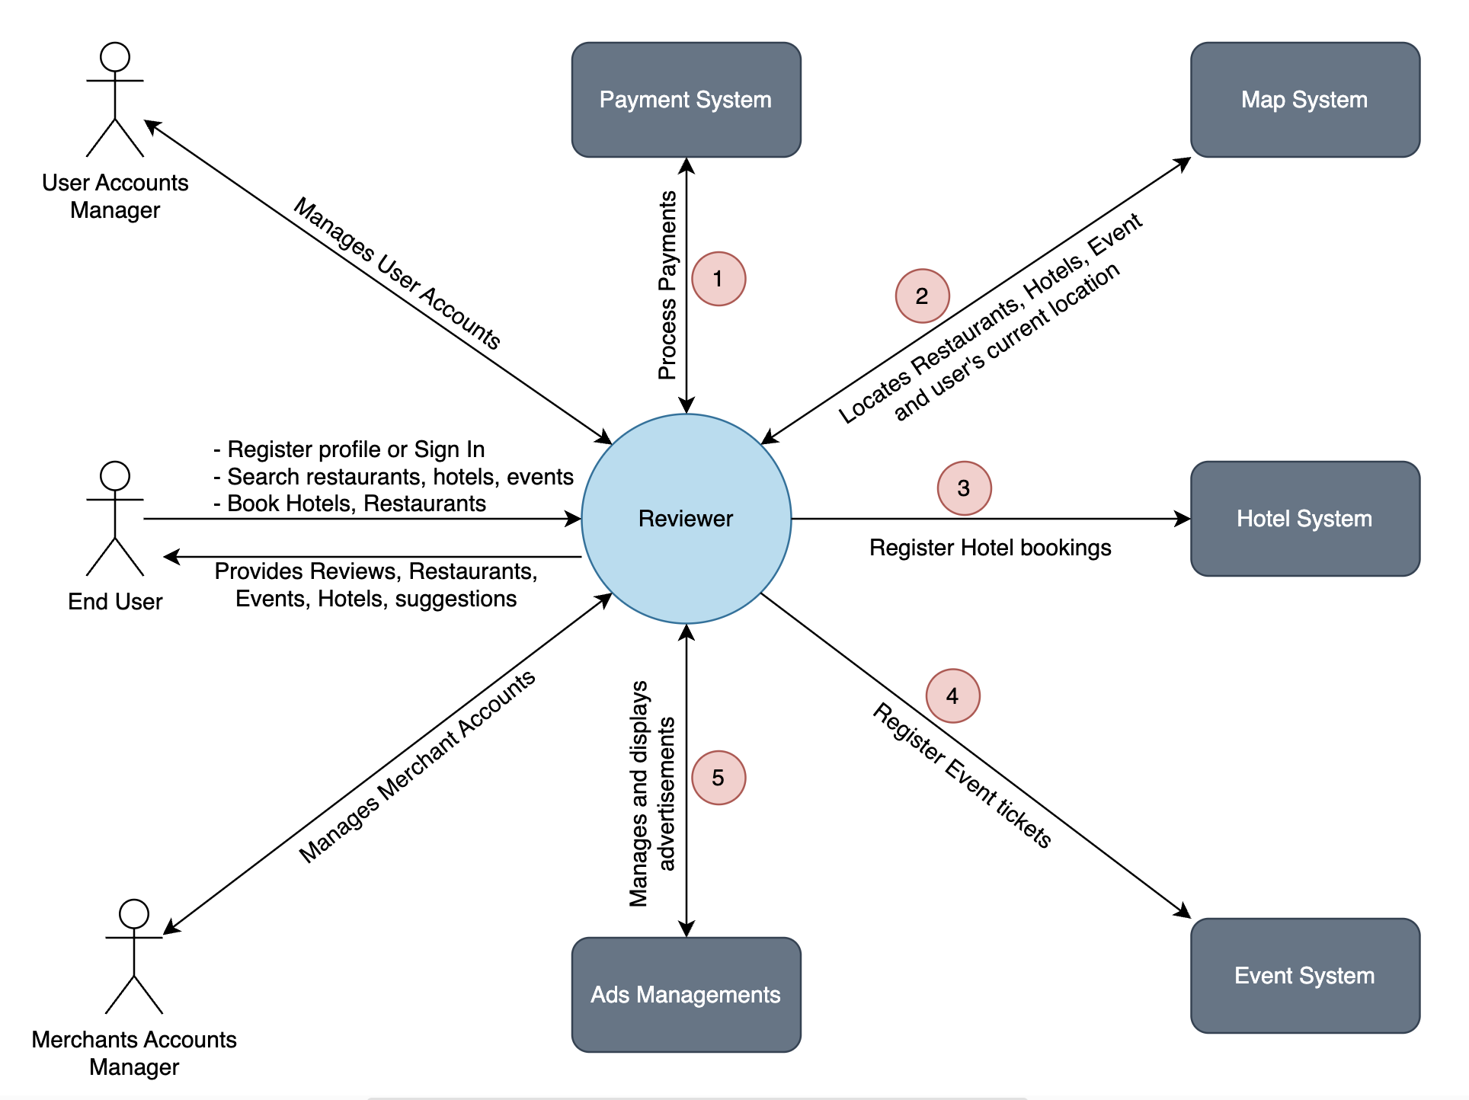
Reviewer - Context Diagram

Slide 2
System Interface Table
No | Description | Source | Target | Frequency | Validation
1 | Process Payments | Payment System | Reviewer | During Transaction | Payment ID is associated and mapped with Ticket ID or booking ID
2 | Locates Restaurants, Hotels, Events and User’s current location | Map System | Reviewer | Real Time | User allows location while visiting website
3 | Register Hotel Booking in the respective site | Reviewer | Hotel System | Real Time | User ID is associated and mapped with booking ID.
4 | Register Event Tickets in the respective site | Reviewer | Event System | Real Time | User ID is associated and mapped with Ticket ID.
5 | Manages and Displays Advertisements | Ads Management | Reviewer | Real Time | Ads are validated by third-party vendor using user’s search history.

